Slide 1

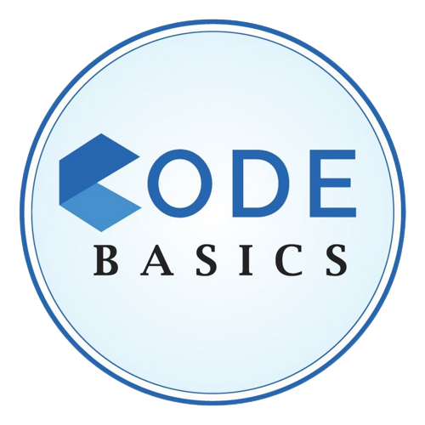

Analyzing Growth and Presenting Insights to the Telangana Government.
BY: ALLAM SRIDHAR

Slide 2

Telangana:
India's youngest state, affectionately known as "The Youngest State" for its fresh outlook, "The Land of Nizams" for its rich heritage, and "India's Technological Hub" for its cutting-edge innovation. Founded in 2014, it's a dynamic blend of history and technology, with Hyderabad as its vibrant centre.
Today, we explore Telangana's growth, bridging tradition and tech. Join us in unravelling its unique story.

Slide 3
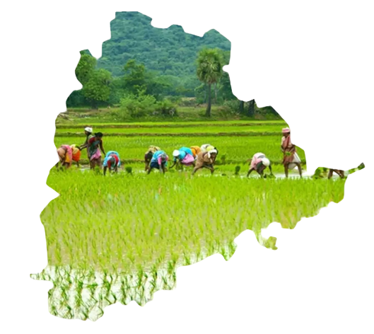
Contents
01-objectives
02-Research analysis
03-suggestions of insights
04-telangana timeline graph from 2014 to present

Slide 4
Objectives :
Exploring Stamp Registration, Transportation and TS-iPASS Datasets and understanding their attributes, categories and time period.
Analysing the trends and patterns within each department.
Identifying growth opportunities and areas needing attention.
Finding the correlation among these departments and report the overall growth of the state through insights and relevant visuals such as shape maps.

Slide 5
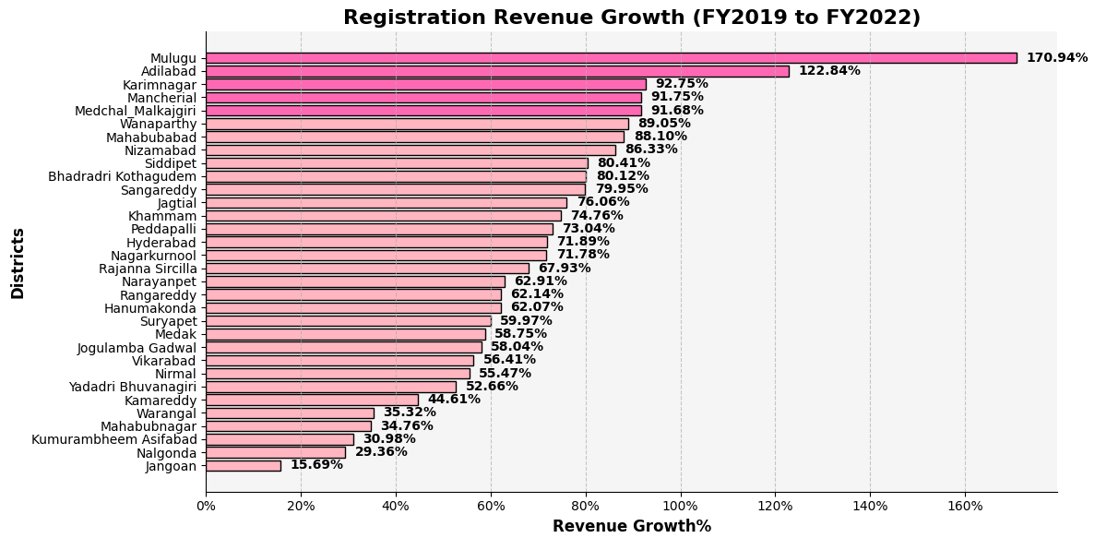
Q1. How does the revenue generated from document registration vary across districts in Telangana? List down the top 5 districts that showed the highest document registration revenue growth between FY 2019 and 2022?
The top 5 districts with the highest document registration revenue growth between FY 2019 and 2022 are:
Mulugu (170.94%)
Adilabad (122.84%)
Karimnagar (92.75%)
Mancherial (91.75%)
Medchal_Malkajgiri (91.68%)

Slide 6
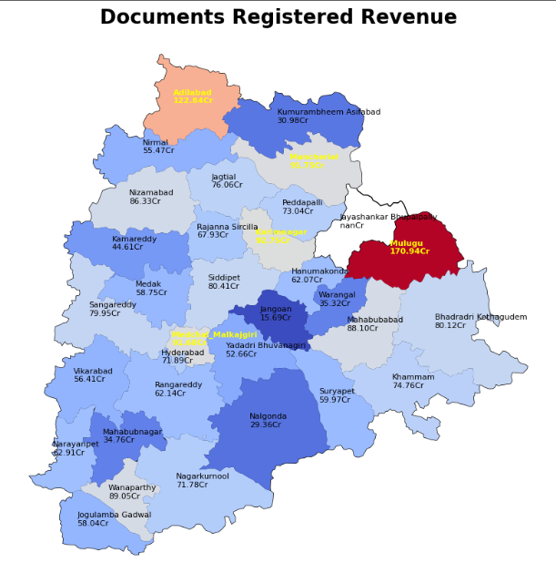

Reasons for high document registration revenue growth in these districts:
Mulugu: Rapid urbanization, government development initiatives
Adilabad: Mineral resources, tourism
Karimnagar: Agriculture, textile industry
Mancherial: Industrialization, government development initiatives
Medchal Malkajgiri: Proximity to Hyderabad, IT industry

Slide 7
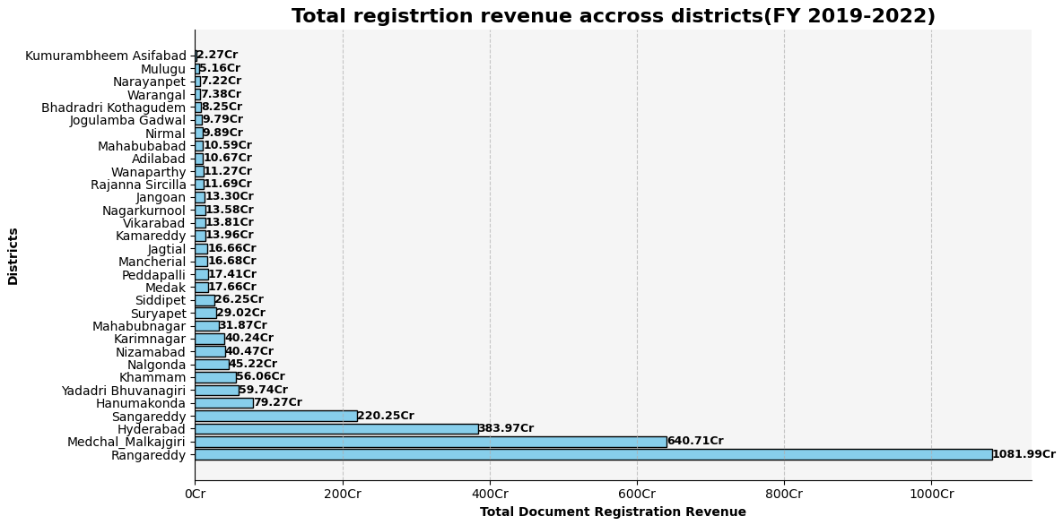
Note:
Only top 4 districts put together generated the 78.8% of total Registration Revenue generated in entire Telangana
Reason:
Proximity to Hyderabad:
The location of these districts around Hyderabad, the capital of Telangana and a major economic hub, has led to increased investment and development, which has boosted registration revenue.
For example, Ranga Reddy district is home to a number of IT companies and manufacturing facilities, while Medchal­­_Malkajgiri district is home to the Hyderabad International Airport. The proximity of these districts to Hyderabad has made them attractive destinations for businesses and individuals, which has led to increased demand for housing and other assets, which has further boosted registration revenue.

Slide 8
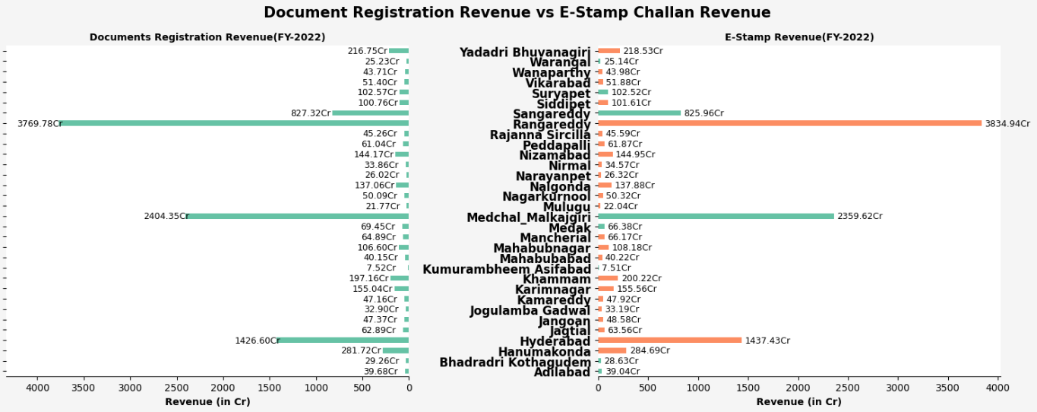
Q2. How does the revenue generated from document registration compare to the revenue generated from e-stamp challans across districts? List down the top 5 districts where e-stamps revenue contributes significantly more to the revenue than the documents in FY 2022?”
Here color indicates that the particular districts e-stamp revenue is more than that of its documents registration revenue

Slide 9
The top 5 districts where e-stamps revenue contributes significantly more to the revenue than the documents in FY 2022 are:
RangaReddy (3834.84Cr)
Hyderabad (1437.43Cr)
Hanumakonda (284.69Cr)
Yadadri Bhuvanagiri (218.53Cr)
Khammam (200.22Cr)
Possible reasons for the high e-stamps revenue in these districts:
Urbanization: Economic growth
High transaction volume
High awareness of e-stamps
Government promotion of e-stamps
High economic activity
Shift from paper-based transactions to digital transactions

Slide 10
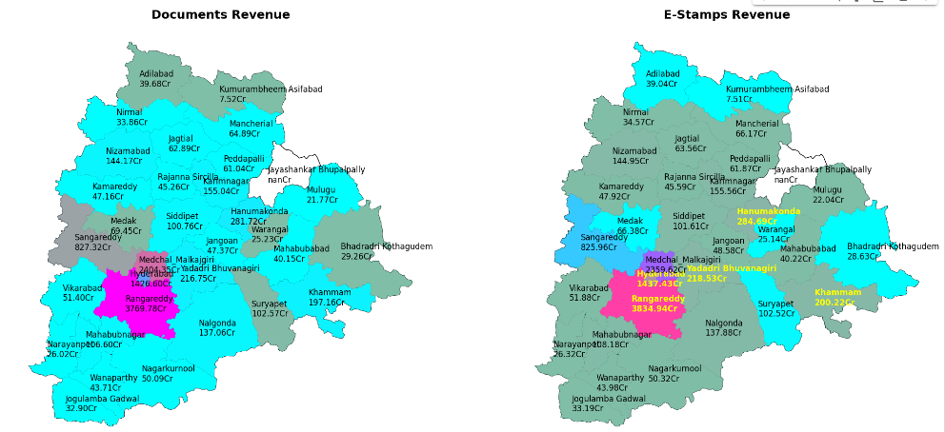
Documents Revenue
E-stamp Revenue
Indicates its value is greater than the e-stamp revenue
Indicates its value is greater than the document revenue
Conclusion:
The high e-stamps revenue in these districts is a positive sign for the Telangana economy. It indicates that these districts are experiencing rapid urbanization and economic growth. The government should continue to promote the use of e-stamps to make it easier for businesses and individuals to conduct transactions.

Slide 11
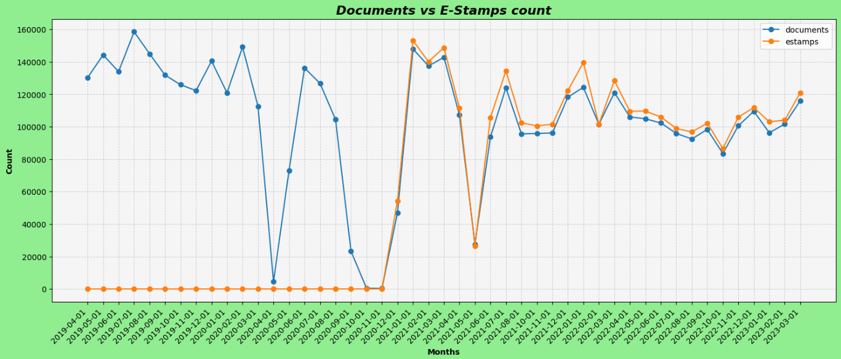
Q3. Is there any alteration of e-Stamp challan count and document registration count pattern since the implementation of e-Stamp challan? If so, what suggestions would you propose to the government?
Since the implementation of e-stamp challans in Telangana in April 2016, the number of e-stamp challans has consistently exceeded the number of document registrations. This suggests that there has been a shift from paper-based transactions to digital transactions.
Possible reasons for this shift include:
Convenience
Awareness
Government initiatives

Slide 12
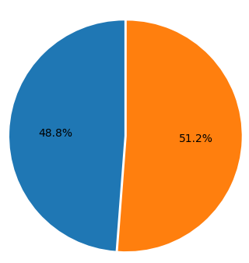
Registration count since implementation of e-stamp challans (i.e. 01-12-2020)
Suggestions:
The Telangana government can continue to encourage the use of e-stamp challans by:
Making it even easier to purchase and use e-stamp challans: For example, the government could make it possible to purchase e-stamp challans using mobile wallets and other popular payment methods.
Promoting the use of e-stamp challans among businesses and individuals: The government could launch public awareness campaigns and offer incentives to businesses and individuals who use e-stamp challans.
Integrating e-stamp challans with other government services: For example, the government could integrate e-stamp challans with the online property registration system. This would make it easier for businesses and individuals to pay stamp duty and other fees when registering property.
E-stamps challans count
Documents registration count
From the pie chart we can see that since 2020 December till now out of 100, 51.2% of transactions has been a shift from paper-based transactions to digital transactions

Slide 13
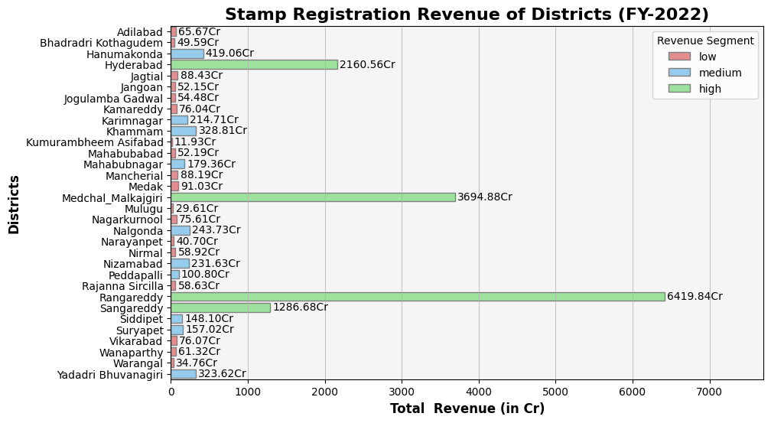
Q4. Categorize districts into three segments based on their stamp registration revenue generation during the fiscal year 2021 to 2022
We have classified districts into three segments based on stamp registration revenue
Classifications:
Low: 0 - 100 Cr
Medium: 101 – 1000 Cr
High: 1000+ Cr

Slide 14
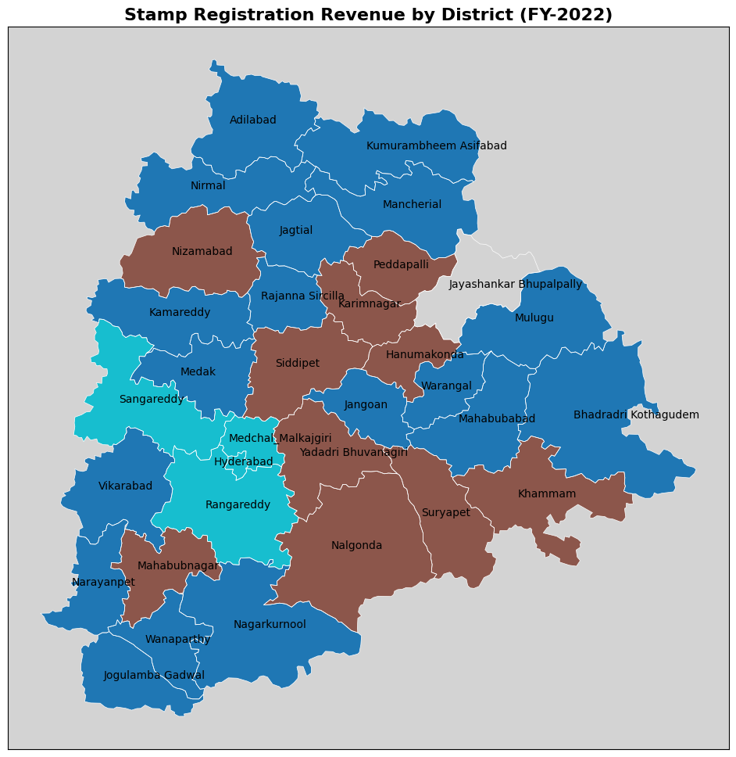
High
Medium
Low
Suggestions for improving the performance of the low category districts in terms of stamp registration revenue generation:
Improve infrastructure and business environment
Promote the use of e-stamp challans
Provide incentives to businesses and individuals
Raise awareness of the importance of stamp registration

Slide 15
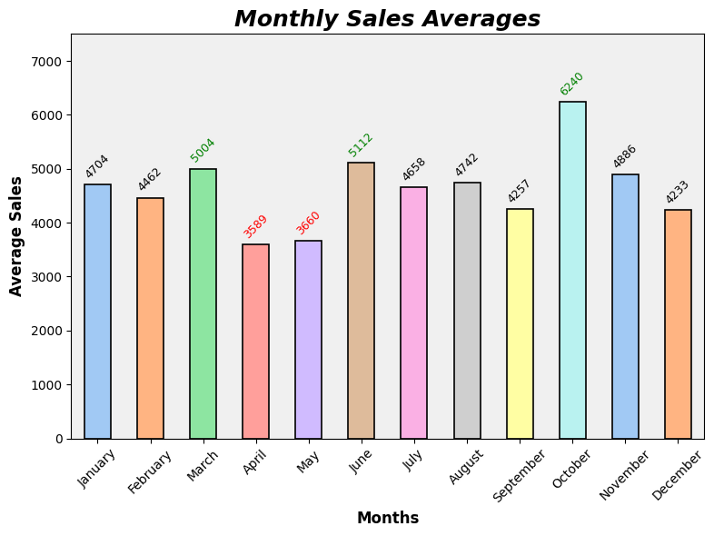
Q5. Investigate whether there is any correlation between vehicle sales and specific months or seasons in different districts. Are there any months or seasons that consistently show higher or lower sales rate, and if yes, what could be the driving factors? (Consider Fuel-Type category only)
Yes, there is a correlation between vehicle sales and specific months or seasons in different districts. The following are some of the possible driving factors behind the higher sales rates and lower sales rate in months of October, June, March and April, May respectively
October: Higher sales due to festivals, bonus season, and new model launches.
June: Higher sales due to school holidays, summer vacations, and year-end offers.
March: Higher sales due to year-end rush and new academic year.
April and May: Lower sales due to hot weather and exam season.

Slide 16
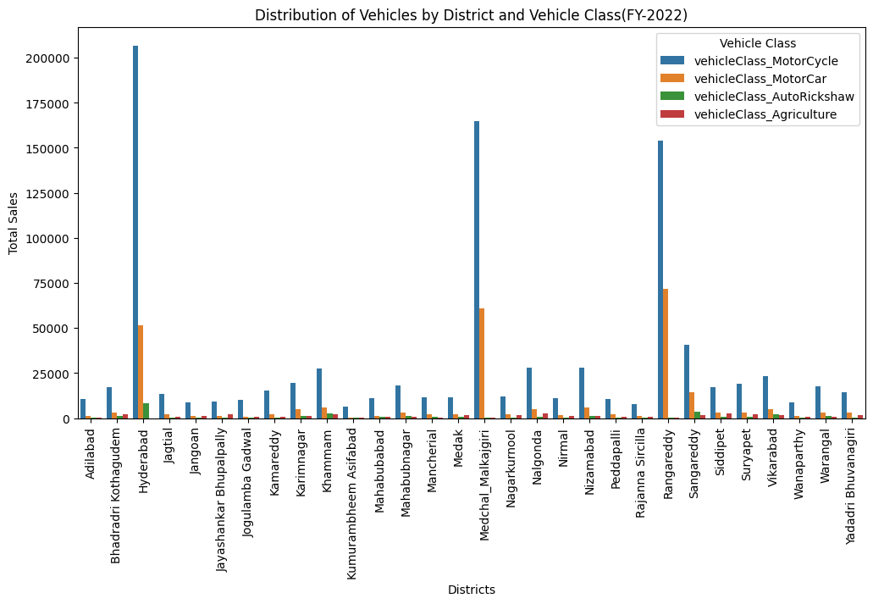
Q6. How does the distribution of vehicles vary by vehicle class (Motorcycle, Motorcar, Autorickshaw, Agriculture) across different districts? Are there any districts with a predominant preference for a specific vehicle class? Consider FY 2022 for analysis.
Vehicle class distribution across districts in Telangana FY 2019-2022:
Motorcycles are the most popular vehicle class in all districts, accounting for over 89% of the total vehicle population.
The distribution of vehicles by vehicle class has not changed significantly between FY 2019 and FY 2022.
Possible reasons for the popularity of Motorcycles include their affordability, fuel efficiency, and ease of maneuverability.

Slide 17
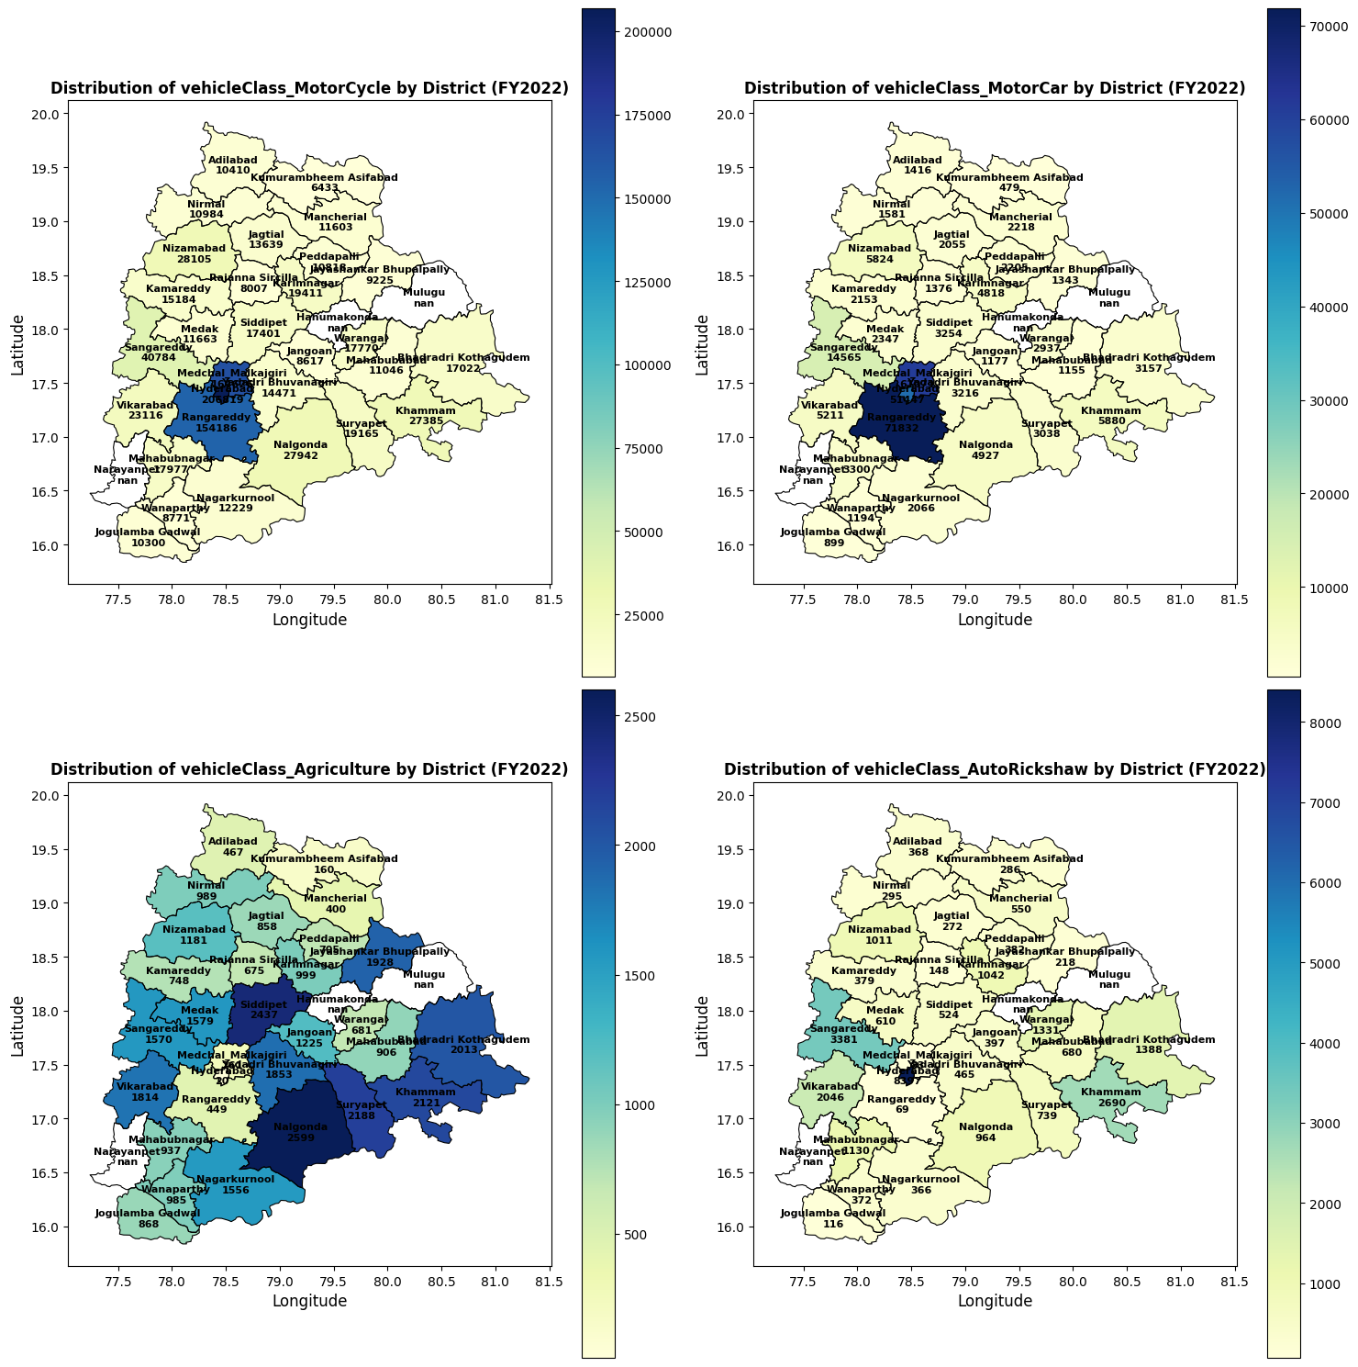
Top 3 Districts of each Vehicle Class in FY-2022
MotorCycle:
Hyderabad
Medchal-Malkajgiri
Ranga Reddy
MotorCar:
Ranga Reddy
Medchal-Malkajgiri
Hyderabad
Auto-Rickshaw:
Hyderabad
Sanga Reddy
Khammam
Agriculture:
Nalgonda
Siddipet
Suryapet

Slide 18
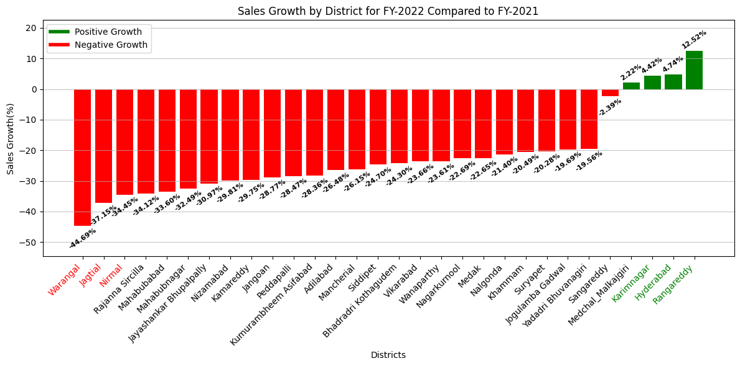
Q7. List down the top 3 and bottom 3 districts that have shown the highest and lowest vehicle sales growth during FY 2022 compared to FY 2021? (Consider and compare categories: Petrol, Diesel and Electric)
Top 3 districts with the highest vehicle sales growth during FY 2022 compared to FY 2021:
Ranga Reddy :12.52%
Hyderabad : 4.74%
Karimnagar : 4.42%
Bottom 3 districts with the lowest vehicle sales growth during FY 2022 compared to FY 2021:
Nirmal: -34.45%
Jagityal: -37.15%
Warangal: -44.69%

Slide 19
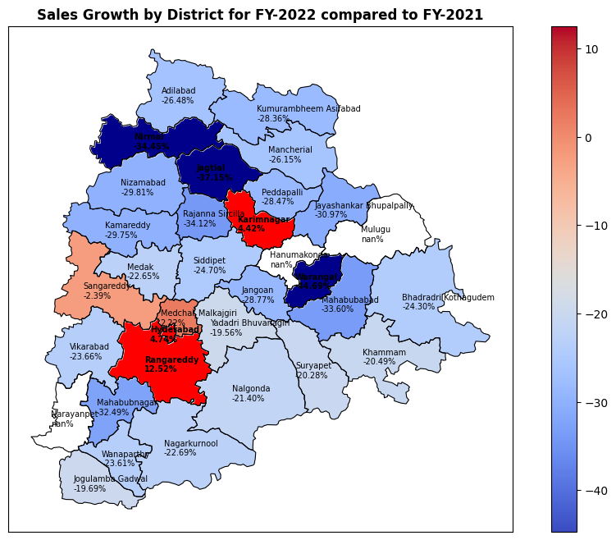
There are a number of possible reasons for the variation in vehicle sales growth across districts. Some of these factors include:
Economic growth
Population growth
Infrastructure
Government policies
The government can take a number of steps to promote vehicle sales growth in all districts. For example, the government can invest in infrastructure development in rural areas. The government can also provide subsidies and tax breaks to encourage the purchase of vehicles.

Slide 20
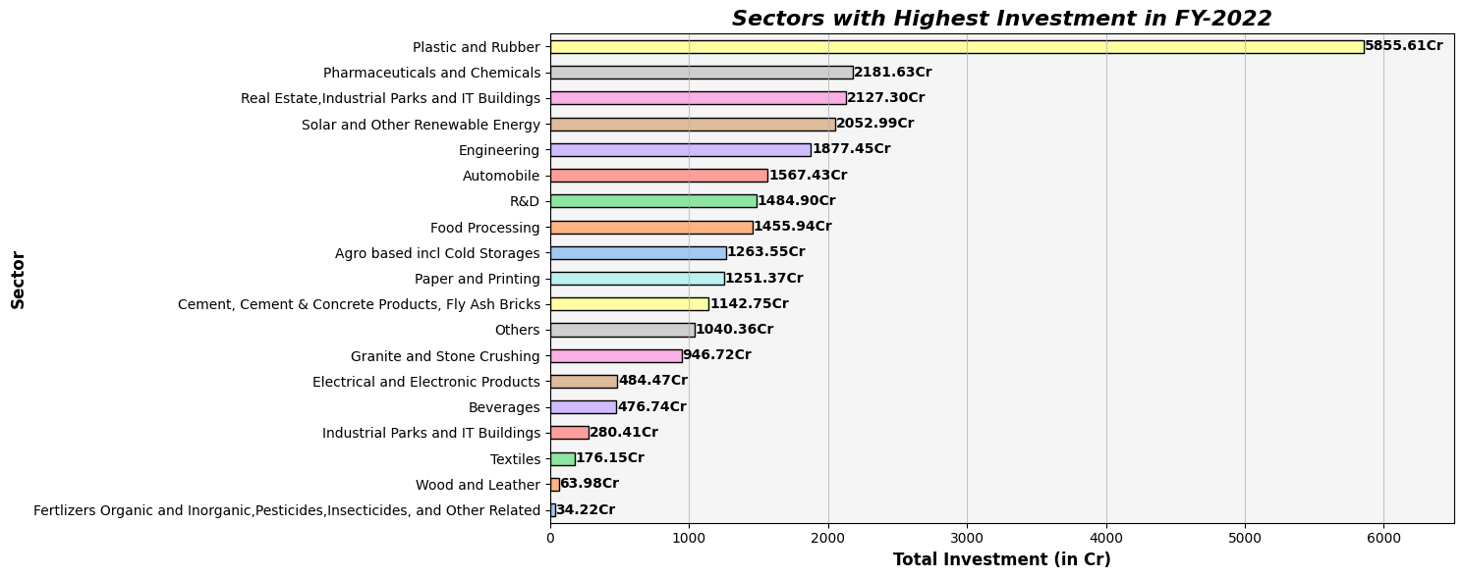
Q8. List down the top 5 sectors that have witnessed the most significant investments in FY 2022.
Top 5 sectors that have witnessed the most significant investments in FY 2022 in Telangana:
Plastic and Rubber - 5855.61Cr
Pharmaceuticals and Chemicals - 2181.63Cr
Real Estate - 2127.30Cr
Industrial Parks and IT Buildings - 2052.99Cr
Solar and Other Renewable Energy - 1877.45Cr

Slide 21
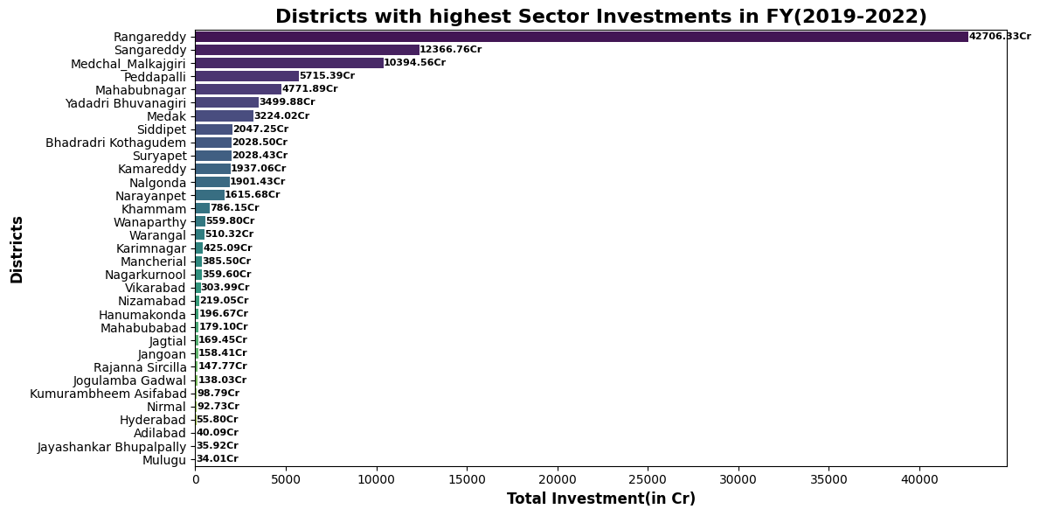
Q9. List down the top 3 districts that have attracted the most significant sector investments during FY 2019 to 2022? What factors could have led to the substantial investments in these particular districts?
Top 3 districts that have attracted the most significant sector investments during FY 2019 to 2022 in Telangana:
Ranga Reddy - 42706.33Cr
Sanga Reddy - 12366.76Cr
Medchal_Malkajgiri - 10394.56Cr

Slide 22
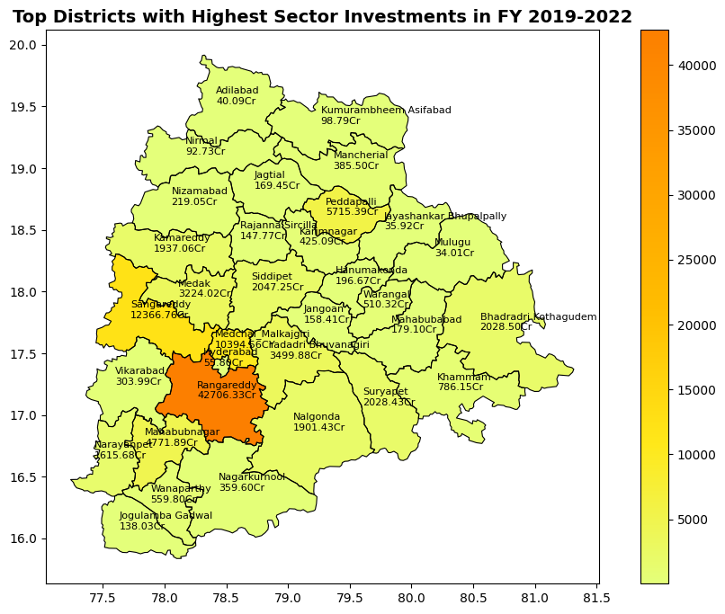
These districts have attracted significant investment due to a number of factors, including:
Proximity to Hyderabad
Government support
Skilled workforce
Presence of other companies
Conducive business environment
Latitude
Longitude

Slide 23
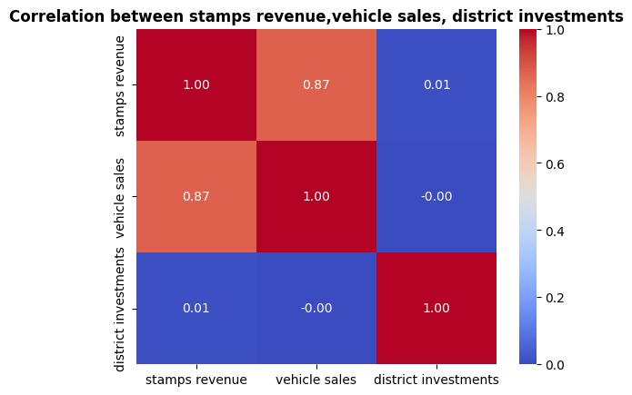
Q10. Is there any relationship between district investments, vehicles sales and stamps revenue within the same district between FY 2021 and 2022?
My analysis of the correlation map:
Strong positive correlation between stamp revenue and vehicle sales (0.87): This is likely due to the fact that an increase in vehicle sales leads to an increase in the number of transactions involving the sale of vehicles, which in turn leads to an increase in stamp revenue.
Weak relationship between stamp revenue and district investment (0.01) and vehicle sales and district investment (-0.00): This could be due to a number of factors, such as the fact that district investment can be in a variety of sectors, not just those that are directly related to vehicle sales. Additionally, district investment may not be immediately realized in terms of vehicle sales.
Conclusion: Overall, the correlation map suggests that there is a strong relationship between stamp revenue and vehicle sales within the same district between FY 2021 and 2022, but a weak relationship between stamp revenue and district investment and vehicle sales and district investment.

Slide 24
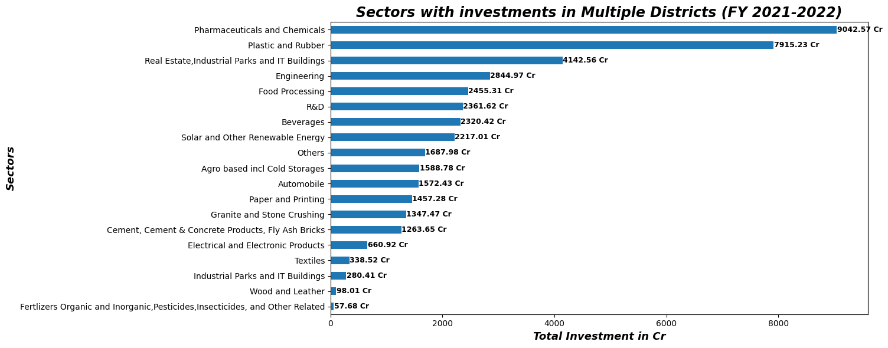
Q11. Are there any particular sectors that have shown substantial investment in multiple districts between FY 2021 and 2022?
Yes, the following sectors have shown substantial investment in multiple districts between FY 2021 and 2022:
Pharmaceuticals and Chemicals (9042.57Cr)
Plastic and Rubber (7915.23Cr)
Real Estate, Industrial Parks, and IT Buildings (4142.56Cr)
Factors such as Government support, Strong Economic Growth, Skilled Workforce have led these sectors to attract significant investment.

Slide 25
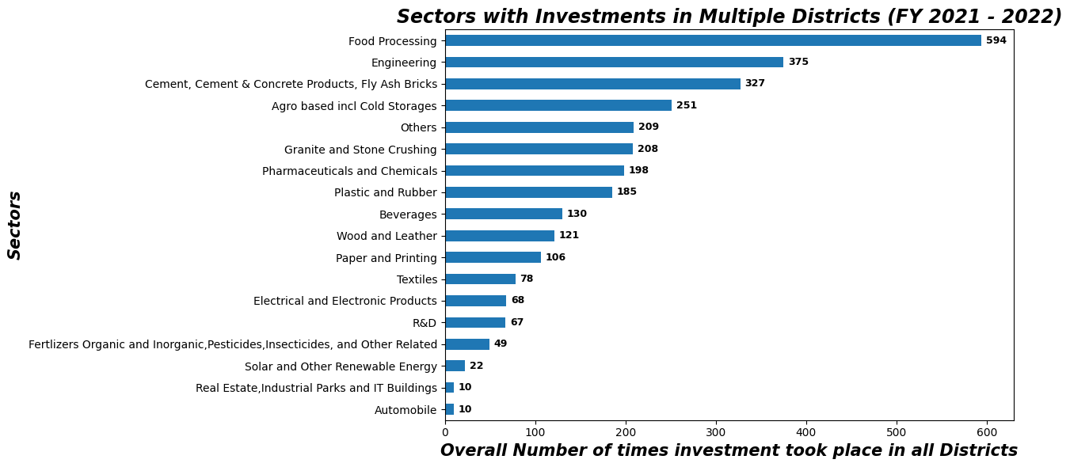
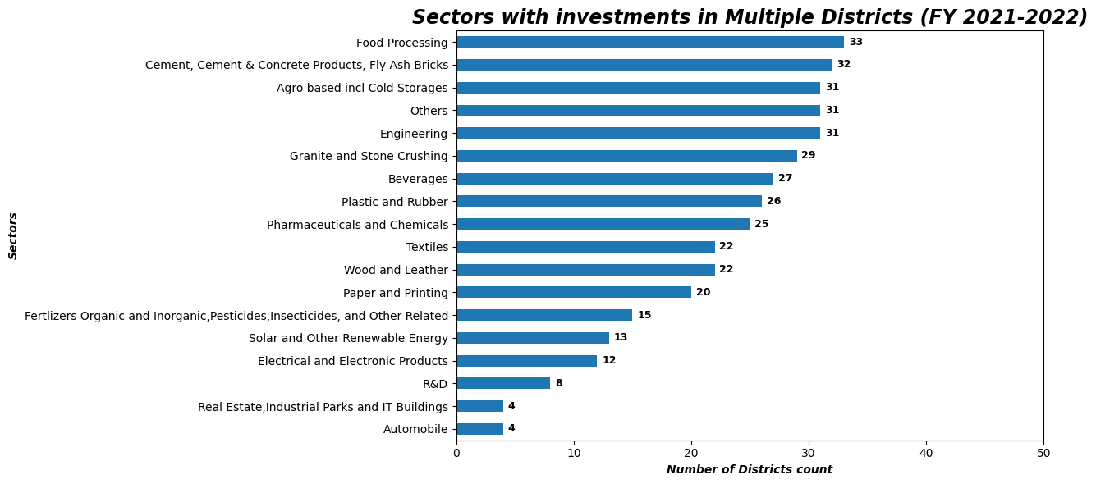
If we consider overall number of times investment took place in district by particular sectors
Then Top three sectors are:
Food Processing
Engineering
Cement & Concrete products
If we consider overall number of unique district by particular sectors
Then Top three sectors are:
Food Processing
Cement & Concrete products
Agro Based and Cold Storages

Slide 26
Q12. Can we identify any seasonal patterns or cyclicality in the investment trends for specific sectors? Do certain sectors experience higher investments during particular months?
Yes, we can identify some seasonal patterns or cyclicality in the investment trends for specific sectors. Yes certain sectors experience higher investments during particular months
Q1(January, February, March)
Food, R&D, Pharmaceuticals and Chemicals
Q2(April, May, June)
R&D, Solar and Other Renewable Energy
Q3(July, August, September)
Wood and Leather, Textiles, Pharmaceuticals and Chemicals, Others
Q4(October, November, December)
Engineering, Food Processing, Beverages
These patterns could be due to a number of factors, such as:
Budget Season (Q2)
Harvest Season (Q4)
Climate
Open below link to see the quarter wise investments of each districts:
https://colab.research.google.com/drive/1ezoQsCcL3erkCdO8JLht4so2EbYxvZIE?usp=sharing

Slide 27
Q1.What are the top 5 districts to buy commercial properties in Telangana? Justify your answer
SECONDARY RESEARCH
The top 5 districts to buy commercial properties in Telangana are:
Hyderabad, Ranga Reddy, Medchal_Malkajgiri, Sanga Reddy, Karimnagar
Justification:
Hyderabad: Hyderabad is the capital of Telangana and is the largest city in the state. It is a major economic and cultural hub, and is home to a number of multinational companies, IT companies, and financial institutions.
Ranga Reddy: Ranga Reddy is a district that is located on the outskirts of Hyderabad. It is home to a number of industrial parks, IT parks, and residential townships.
Medchal_Malkajgiri: Medchal_Malkajgiri is a district that is located on the outskirts of Hyderabad. It is home to a number of industrial parks, IT parks, and residential townships.
Sanga Reddy: Sanga Reddy is a district that is located on the outskirts of Hyderabad. It is home to a number of industrial parks, IT parks, and residential townships.
Karimnagar: Karimnagar is a district that is located in the northern part of Telangana. It is a major agricultural and industrial hub.
These districts have been selected based on the following factors:
Economic growth
Infrastructure
Government support
In addition to the above factors, these districts are also home to a number of educational institutions, hospitals, and other social infrastructure facilities. This makes them attractive destinations for businesses and individuals alike

Slide 28
Q2. What significant policies or initiatives were put into effect to enhance economic growth, investments, and employment in Telangana by the current government? Can we quantify the impact of these policies using available data?
The current government of Telangana has implemented a number of significant policies and initiatives to enhance economic growth, investments, and employment in the state. Some of these key policies and initiatives include TS-iPASS, TS-bPASS, T-Hub, WE HUB, Rythu Bandhu, and Mission Kakatiya.
These policies and initiatives have had a significant impact on the state's economy. For example, the state's GDP has grown at an average rate of 11.2% per year since the formation of the state in 2014, and the state's unemployment rate has fallen from 10.2% in 2014 to 5.6% in 2023.
Overall, the policies and initiatives implemented by the current government of Telangana have had a positive impact on the state's economy.

Slide 29
Q3.Provide top 5 Insights & 5 recommendations to Telangana government for sustained growth in the next 5 years based on your analysis
Insights
Recommendations
Strong Economic Growth: Telangana has experienced robust economic growth since its formation in 2014, with an average annual GSDP growth rate of 11.2%. This growth rate surpasses the national average GDP growth rate of 7.3% during the same period.
Diverse Industrial Base: Telangana boasts a thriving industrial base, housing multinational corporations, IT firms, and pharmaceutical companies.
Skilled Workforce: The state benefits from a skilled workforce produced by numerous educational institutions, ensuring a steady supply of skilled graduates.
Robust Infrastructure: Telangana enjoys well-developed infrastructure, including a comprehensive road and rail network, along with multiple airports.
Business-Friendly Environment: The state government has implemented policies to foster investment and business development.
Infrastructure Investment: Sustained investment in infrastructure is crucial for continued economic growth. Prioritizing projects in transportation, such as roads, bridges, railways, and airports, is essential.
Support for Innovation and Entrepreneurship: The government should bolster its support for startups and entrepreneurs through financial aid, mentorship programs, and additional support services.
Diversify Sectors: Focusing on emerging sectors like renewable energy, electronics, and logistics can diversify the state's economy and create new avenues for growth.
Skill Development: Continued investment in skill development initiatives will ensure a workforce that is adequately equipped to meet the demands of a growing economy.
Streamline Bureaucracy: Simplifying bureaucratic processes will enhance the ease of doing business in Telangana, making it more attractive for both existing and potential enterprises.

Slide 30
TELANGANA TIME LINE PLOT
The world’s largest lift irrigation project- kaleshwaram project
National award for Excellence in skill Development
Double digit economic growth for 5th consecutive year
Mission Kakatiya project
Telangana bags eight National Tourism awards
National Award for Excellence in Agriculture for its Rythu Bandhu program
Dalit Bandhu program
Telangana institute of medical sciences
Telangana state industrial mission
Ranks 1st in terms of literacy rate & institutional deliveries
2015
2023
2017
2019
2021
2020
2016
2022
2018
Ranks 1st in country in terms of renewable energy generation
Achieves 100% rural electrification
National award for excellence in public health
world's largest single-location vaccine manufacturing facility
Mission Bhagiratha
2014
National Award for Excellence in Urban Development for its Mission Kakatiya program
World’s largest Fibre-grid Network
TS-iPASS program
India’s top IT exporter for 2nd year in a row & ranks 1st in country in terms of ease of doing business
Attracted record investments of Rs. 1.6 lakh Crore in 2021-22
Achieves record foodgrain production of 3.14 Crore tonns in 2021-22
Birth of Telangana – India's youngest state

Slide 31
